Slide 1
Computer Science
Understand your environment

Slide 2
What is Windows?

Slide 3
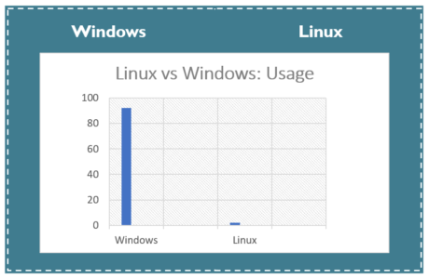
What is Window’s ?
Windows is a licensed operating system and its source code is inaccessible.
It is designed for business owners, other commercial user and even individuals.
It is simple and straightforward to use.

Slide 4
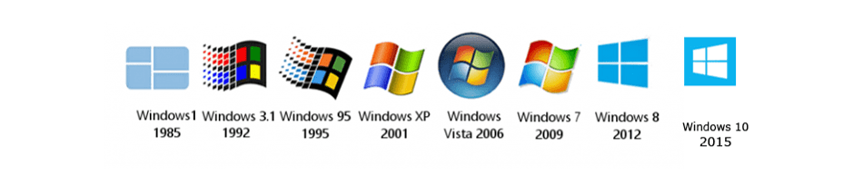
History of Windows
MS-DOS : August 12, 1981; 39 years ago
Windows 9x : produced from 1995 to 2000
Windows XP : October 25, 2001
Windows Vista : January 30, 2007
Windows 8 : Windows 8
Windows 8.1 :October 17, 2013
Windows 10 : July 29, 2015

Slide 5
Windows Specificities
Multiple operating environments
Symmetric multiprocessing
Client-server computing
Virtual memory
Portability
Extensibility
Preemptive scheduling

Slide 6
Windows Command line :
PowerShell

Slide 7
PowerShell
It’s command-line shell and the associated scripting language.
Its analogue in Linux is called as Bash Scripting
Built on the .NET Framework
It’s help to control and automate the administration of the Windows OS.
Or applications that run on Windows Server environment.
Command are named cmdlet.

Slide 8
Cmdlet
Cmdlets are .NET Framework class objects; and not just stand-alone executables.
Cmdlets can be easily constructed from as few as a dozen lines of code.
Parsing, error presentation, and output formatting are not handled by cmdlets. It is done by the Windows PowerShell runtime.
Cmdlets process works on objects not on text stream and objects can be passed as output for pipelining.
Cmdlets are record-based as they process a single object at a time.

Slide 9
Windows script :
PowerShell again !

Slide 10
Example : Print bios info
param( [string]$Computer = "." )
if ( $computer -eq "." ) {
$instances = Get-CimInstance -ClassName "Win32_BIOS" -Namespace "root/cimv2"
} else {
$instances = Get-CimInstance -ClassName "Win32_BIOS" -Namespace "root/cimv2" -ComputerName "$Computer"
}
$count = ( $instances | Measure-Object ).Count
if ( $count -eq 1 ) {
Write-Host "1 instance:"
} else {
Write-Host "$count instances:"
}
Write-Host
foreach ($objItem in $colItems) {
write-host "Name :" $objItem.Name
write-host "Version :" $objItem.Version
write-host "Manufacturer :" $objItem.Manufacturer
write-host "SMBIOSBIOS Version :" $objItem.SMBIOSBIOSVersion
write-host
}

